Slide 1

Early Disease Detection and Resource Optimisation
Presented by Roshan Shrestha(u2732965)

Slide 2
Introduction & Objectives
The primary goal is to analyse patient record for:
Predicting critical vs non-critical cases
Risk clustering
Forecasting hospital admissions

Slide 3
Dataset Overview
Demographics (Age, Gender, Blood Type)
Clinical features (Medical Condition, Medication, Test Results)
Operational data (Admission Type, Dates, Billing)
Dataset source : https://www.kaggle.com/datasets/prasad22/healthcare-dataset

Slide 4
Data Preprocessing
Keep only relevant data column ('Age', 'Gender', 'Blood Type', 'Medical Condition', 'Admission Type', 'Test Results', 'Medication', 'Billing Amount', 'Date of Admission', 'Discharge Date’)
Medical Condition into critical(1) and non-critical(0)
Critical condition keywords ('cancer', 'tumor', 'stroke', 'cardiac', 'arrest', 'heart', 'failure', 'trauma', 'critical', 'coma')
Handled dates: Admission and Discharge
Dropped missing values

Slide 5
Feature Engineering
Length of Stay: Calculated by subtracting admission date from discharge date.
Billing_per_day: Derived by dividing Billing Amount by Length of Stay + 1.
Emergency_Flag: Encoded as binary, with '1' indicating emergency admissions
Gender, Admission Type, and Test Results were label encoded

Slide 6
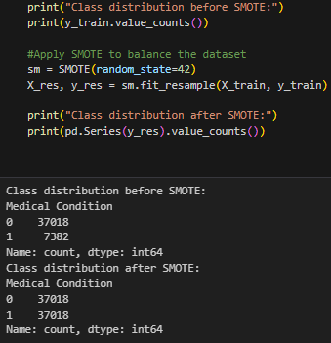
Handling Class Imbalance
Class distribution before SMOTE
Critical: 7382
Non-critical: 37018
Class distribution after SMOTE
balanced both classes to 37,018

Slide 7
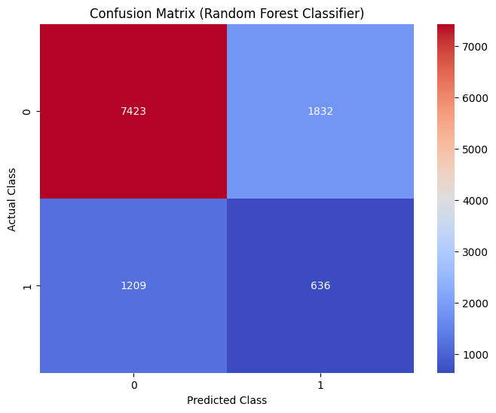
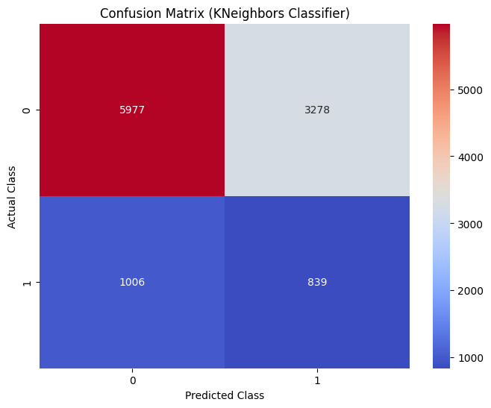
Classification Model – RF & KNN
Random Forest
Accuracy: 72.6%
ROC-AUC: 0.60
K-Nearest Neighbors
Accuracy: 61.4%
ROC-AUC: 0.56

Slide 8
Classification Model – Comparison
Random Forest
Stronger overall classification of non-critical patients (Class 0)
Moderate underperformance in identifying critical patients (Class 1)
K-Nearest Neighbors
Slightly better at detecting critical cases (higher TP)
Much higher false positives → more non-critical cases misclassified
Conclusion
Random Forest is more reliable overall with better precision and lower false alarms
KNN could be used as a secondary screening model where sensitivity is prioritized over specificity

Slide 9
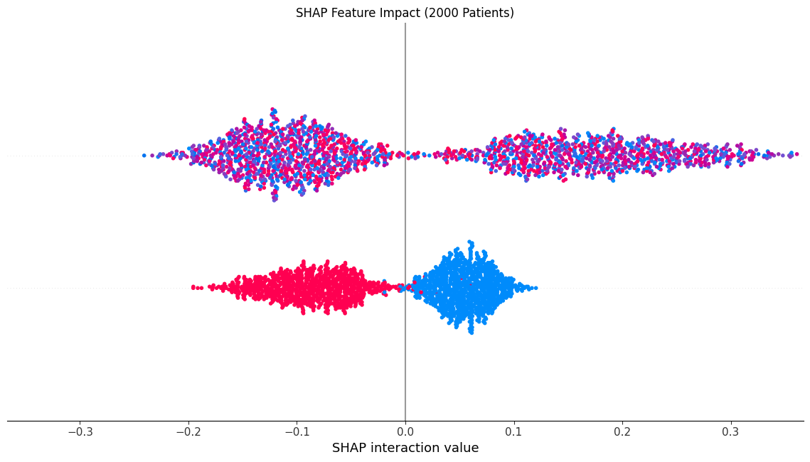
Model Explainability
Each dot in the SHAP plot represents:
A SHAP value for a feature
One patient instance
Colour gradient (red to blue): High to low feature values
X-axis position: Impact of that feature on the prediction

Slide 10
Model Explainability
Billing_per_day had the strongest impact on predicting critical patients
High billing per day (in red) pushed predictions toward the critical class
Length of Stay also increased critical classification
Lower values of these features pushed predictions toward the non-critical class

Slide 11
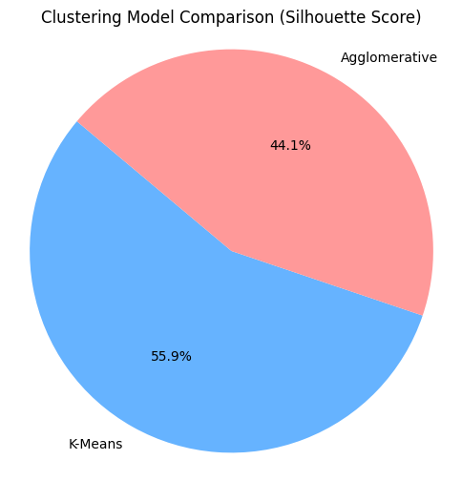
Clustering Approach
Used features: Age, Billing, Length of Stay
Methods:
KMeans (Silhouette: 0.243)
Agglomerative (Silhouette: 0.192)
Objective: Segment patient data using unsupervised learning
Goal: Identify hidden patient groups to support risk stratification and resource planning

Slide 12
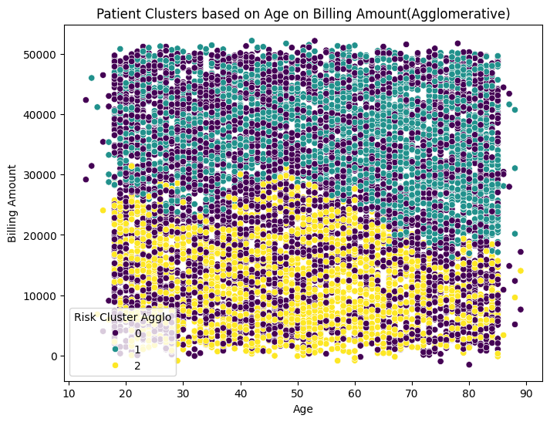
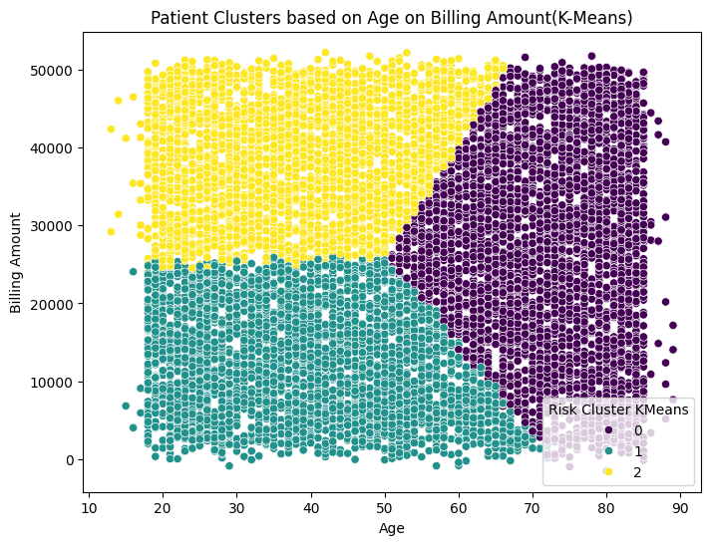
Clustering Visualisations
Agglomerative Clustering
Silhouette Score: 0.192
Davies-Bouldin Index: 1.433
Interpretation: Weaker clustering performance with more overlap
K-Means Clustering
Silhouette Score: 0.243
Davies-Bouldin Index: 1.306
Interpretation: Stronger internal cohesion and better separation between clusters

Slide 13
Clustering Visualisations
Agglomerative Clustering
More dispersed and overlapping clusters
May be less actionable in a hospital setting where clear, distinct groups are needed
K-Means
More compact and distinct clusters, especially along Age and Billing Amount
Effectively identifies patient groupings based on cost and care duration

Slide 14
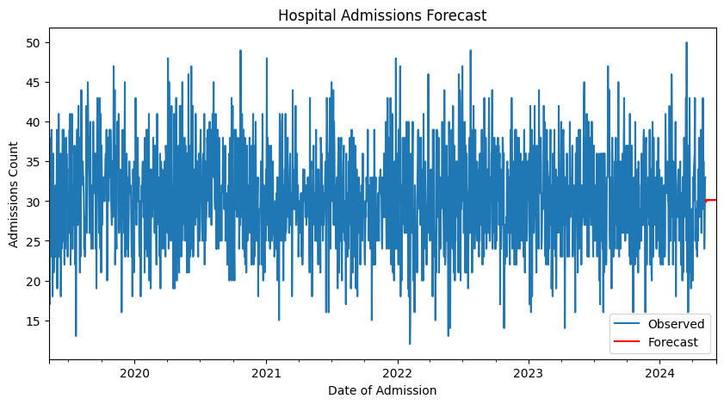
Forecasting Hospital Load
Used ARIMA model(3,1,2)
Forecasted daily admissions for 30 days

Slide 15
Forecast Evaluation
Performance Metrics:
MAE: 4.467
RMSE: 5.663
Indicates low deviation from actual values → suitable for short-term hospital planning
Model captures trend with minor noise

Slide 16

Conclusion
Successfully built a predictive pipeline using real healthcare data:
Balanced classification of critical vs. non-critical cases
Unsupervised clustering for patient segmentation
Time-series forecasting for hospital admissions
Key findings:
Random Forest outperformed KNN for classification (AUC: 0.60)
K-Means yielded better patient clusters (Silhouette: 0.243)
ARIMA (3,1,2) effectively forecasted short-term admission trends
Interpretability tools like SHAP enhanced clinical transparency

Slide 17

Any Question ?

